Slide 1
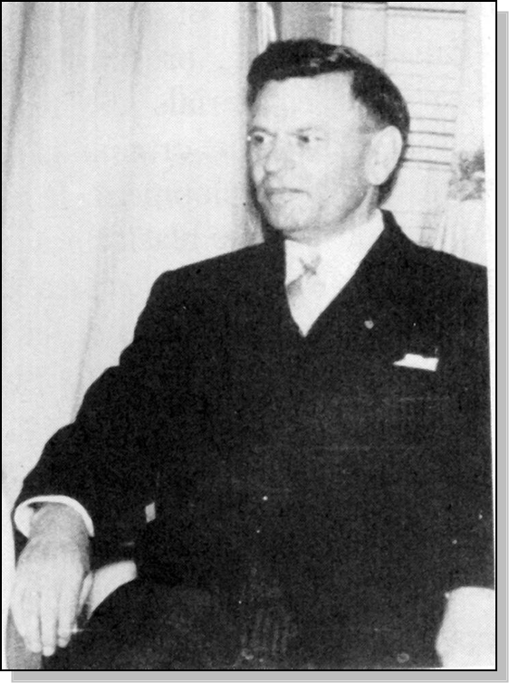

Lecture 16
Chemical Engineering for Micro/Nano Fabrication
Oskar Süẞ (Suess)

Slide 2
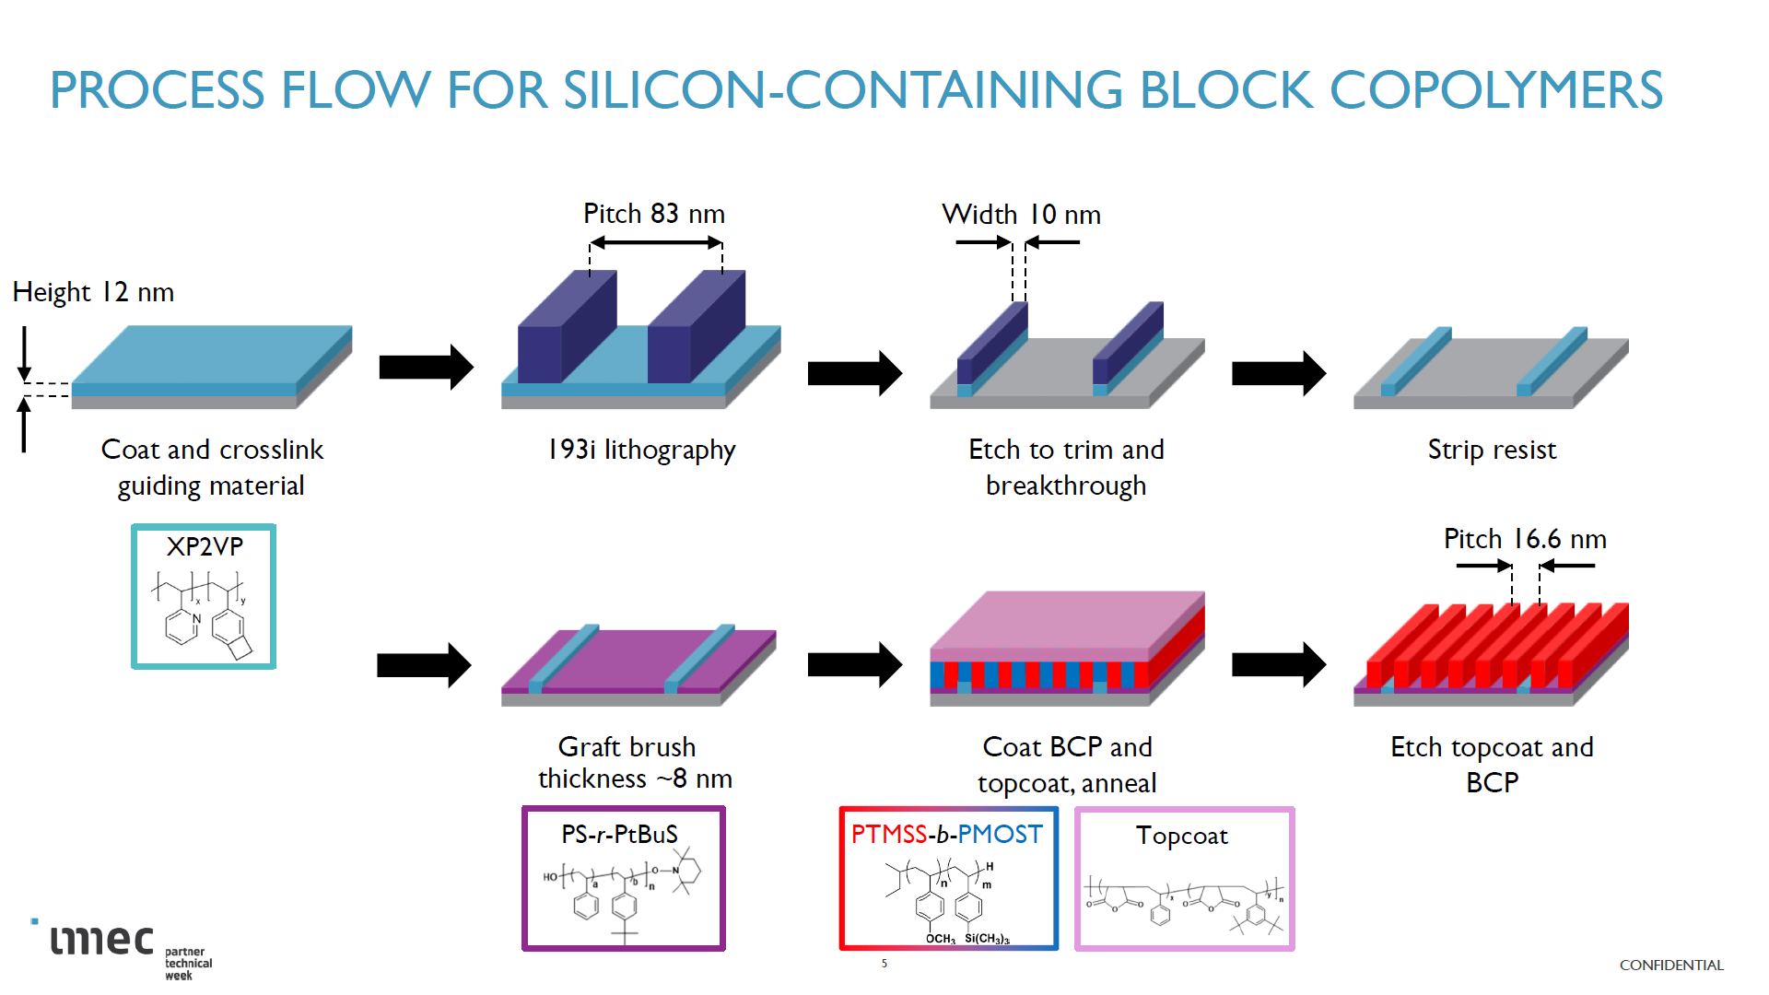

Slide 3
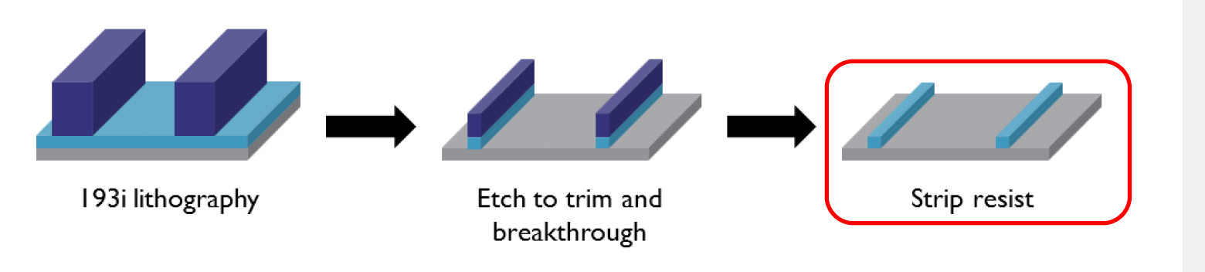
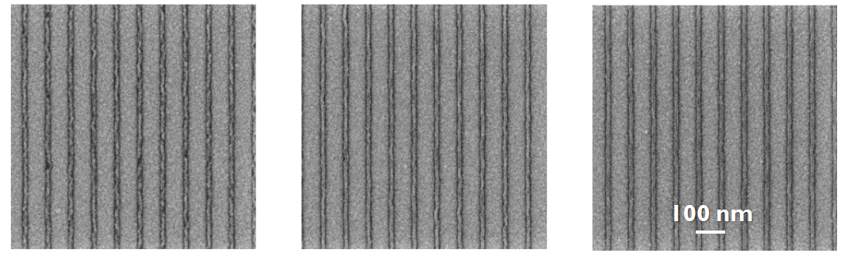
Guide line by 193 Immersion and trim etch

Slide 4


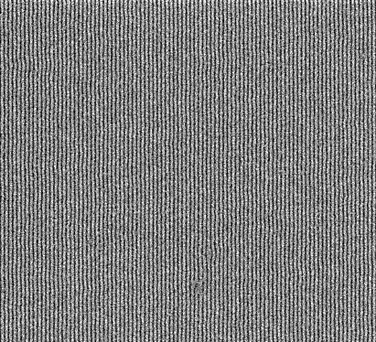


Greg in Belgium!
Gregory Blachut
L₀ = 19.7 nm
200nm
PMOST-PTMSS
Chem. Mater 28(24)8951-8961 (2016)

Slide 5



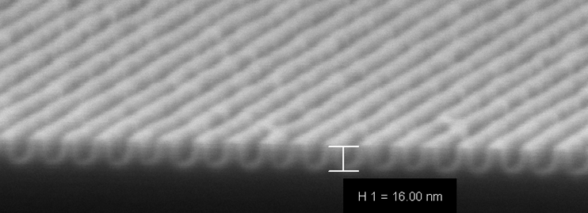

Directed Assembly at HGST
Electron Beam written Guide patterns
10 nm Lines and spaces
Julie
Ricardo
ACS Appl. Mater. Interfaces 2015, 7, 13476

Slide 6

Design for n=4 & 0.5L_{o} where L_{o} =20
Challenging Lithography
40nm lines and spaces
Line is subsequently “trim etched” to 10nm
This is the theoretical limit for 193nm immersion litho
Top coat should be perfectly neutral
Brush approaches neutral with increasing multiplication
Guide line should strongly favor one block

Slide 7
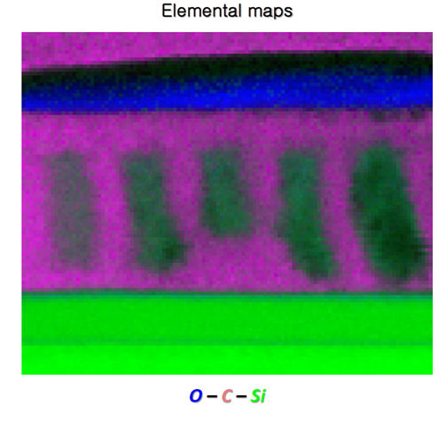



Possible Interpretation of Imec Cross sections
TEM/EELS of Cross section
23 ± 1 nm
Score: 178K

Slide 8
Relaxed Optical Litho Proposal
Design for n=4, L_{o} = 20
80nm
80nm
Polar oxidized sidewall
Top coat and XST should be perfectly neutral for all n
Requires selective reaction of the brush with substrate not sidewall !!

Slide 9

5 nm DSA using Imprint Lithography
O₂ RIE
Selective
brush graft
to Chromium
Imprint
Resist
Chromium
Brush
Wafer
Apply BCP
Apply TC
Top Coat
develop TC
Anneal
190˚C
2 min
BCP

Slide 10
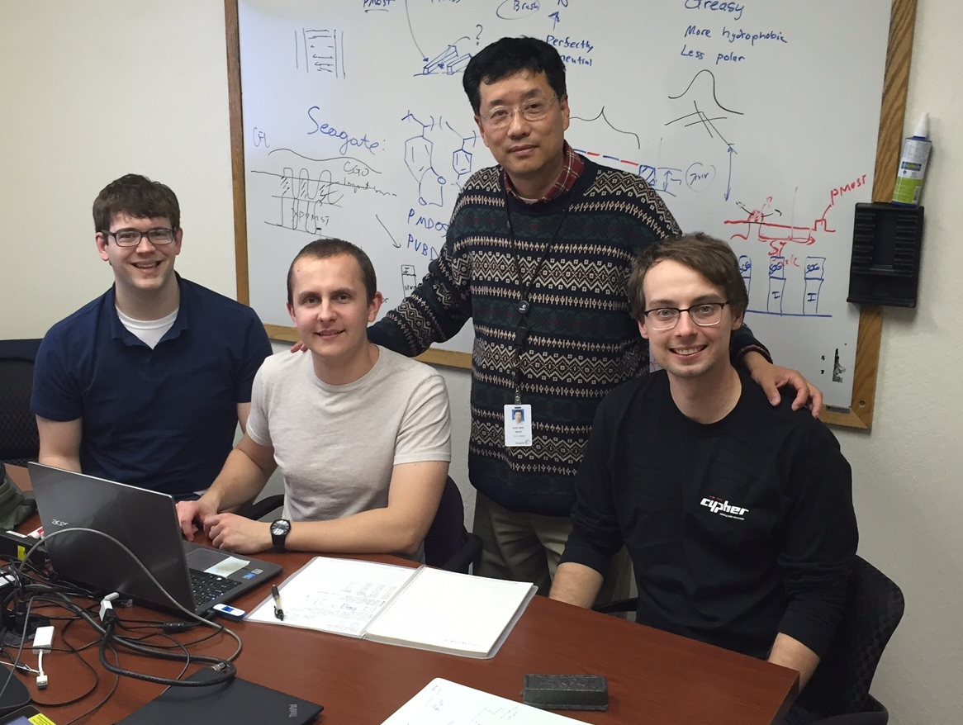

50 Å lines and spaces
Notes:
To start things off, I’d just like to show you the final result of our hard work at Seagate. What you see here is a top-down SEM of aligned BCP lamellae. Each of these lines is 5 nm wide. We are particularly proud of this result because we don’t think DSA has ever been done before using features this small, although people are getting close. From Seagate’s perspective, they would like to take each of these lines defined by the block copolymer and chop them up into small rectangles, and that process can eventually be done using a variety of methods. As rectangles, they would be useful in defining the individual bits, the 1s and 0s in a hard disk drive. The technology of inidividually patterning bits like this is known as bit patterned media, and it is being investigated because it offers HDD manufacturers to scale storage density to something like 5 Tb/in^2 of data, maybe more.

Slide 11


Looks great from the top!!
Elemental Overlay Map
C-Si-Cr
(Map contrasts are optimized to show element distributions, they are not directly proportional to actual abundances)b

Slide 12
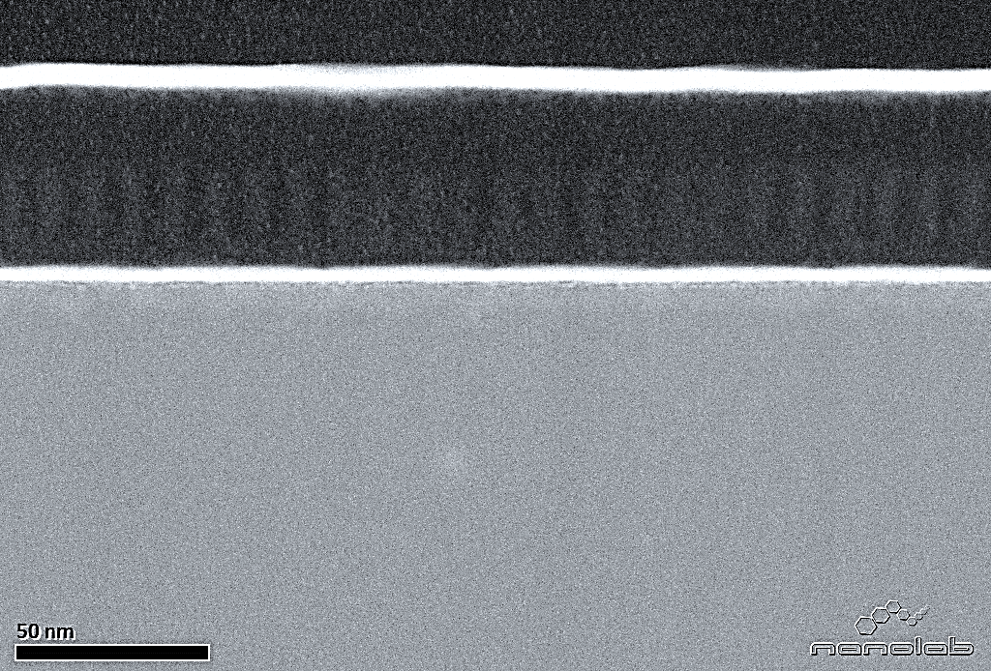
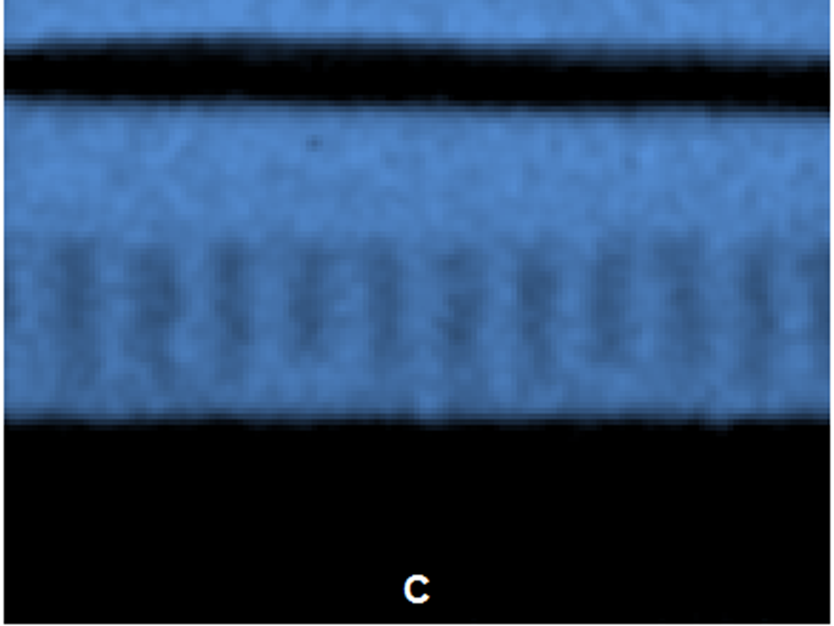

STEM Cross sections of Latest 5nm Process

Slide 13



Etch developed 50 Å lines and spaces
collaboration with

Slide 14
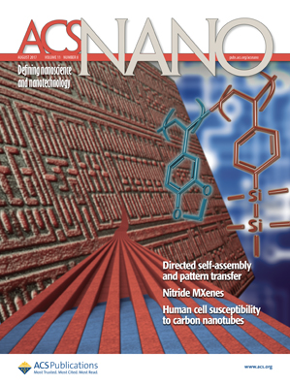

Slide 15
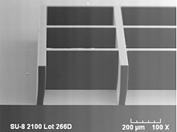
Back to Resists

Slide 16
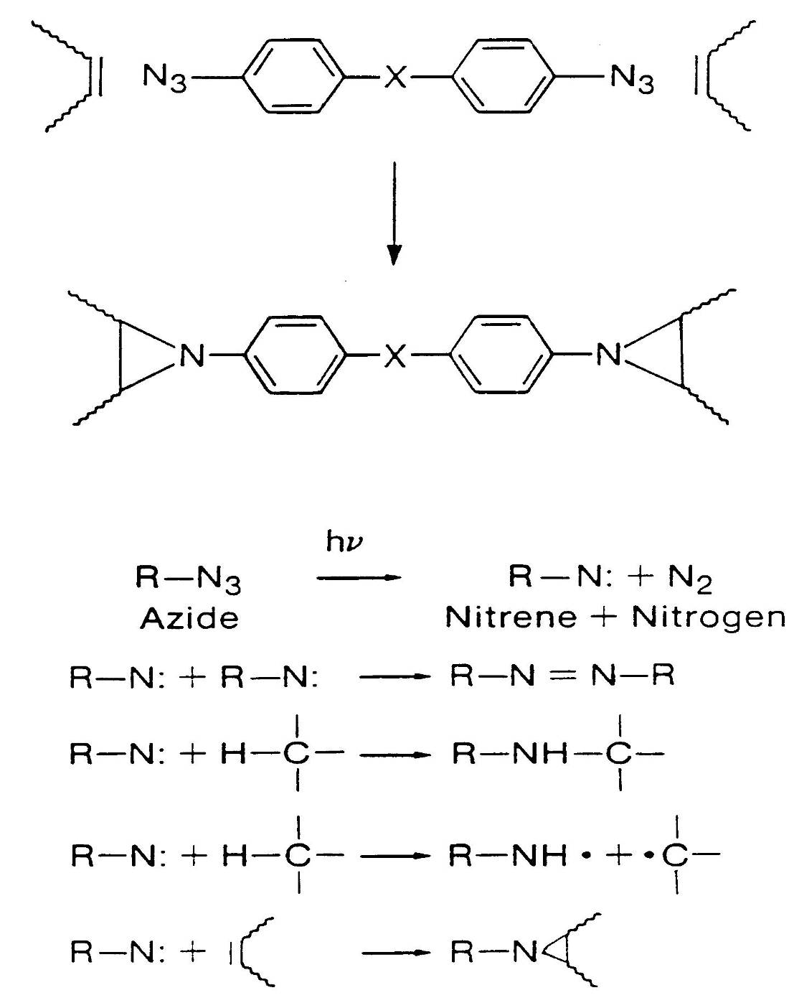
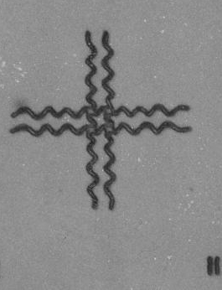
Recall
KTFR

Slide 17
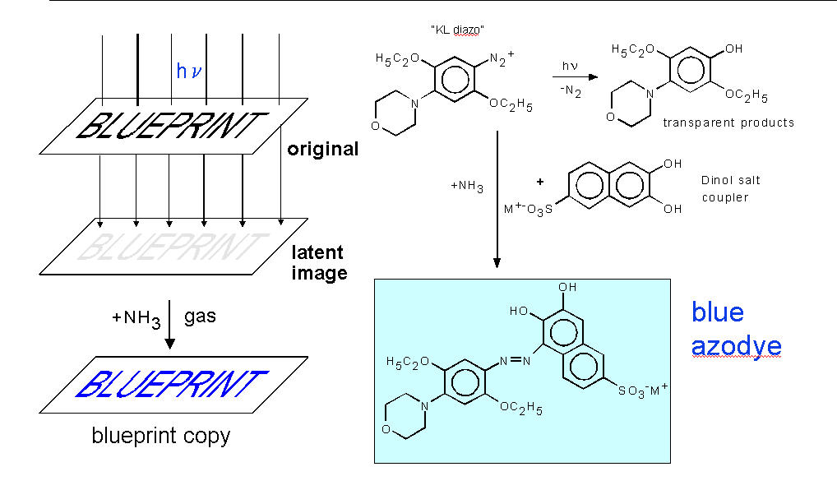
Blue Print Chemistry

Slide 18
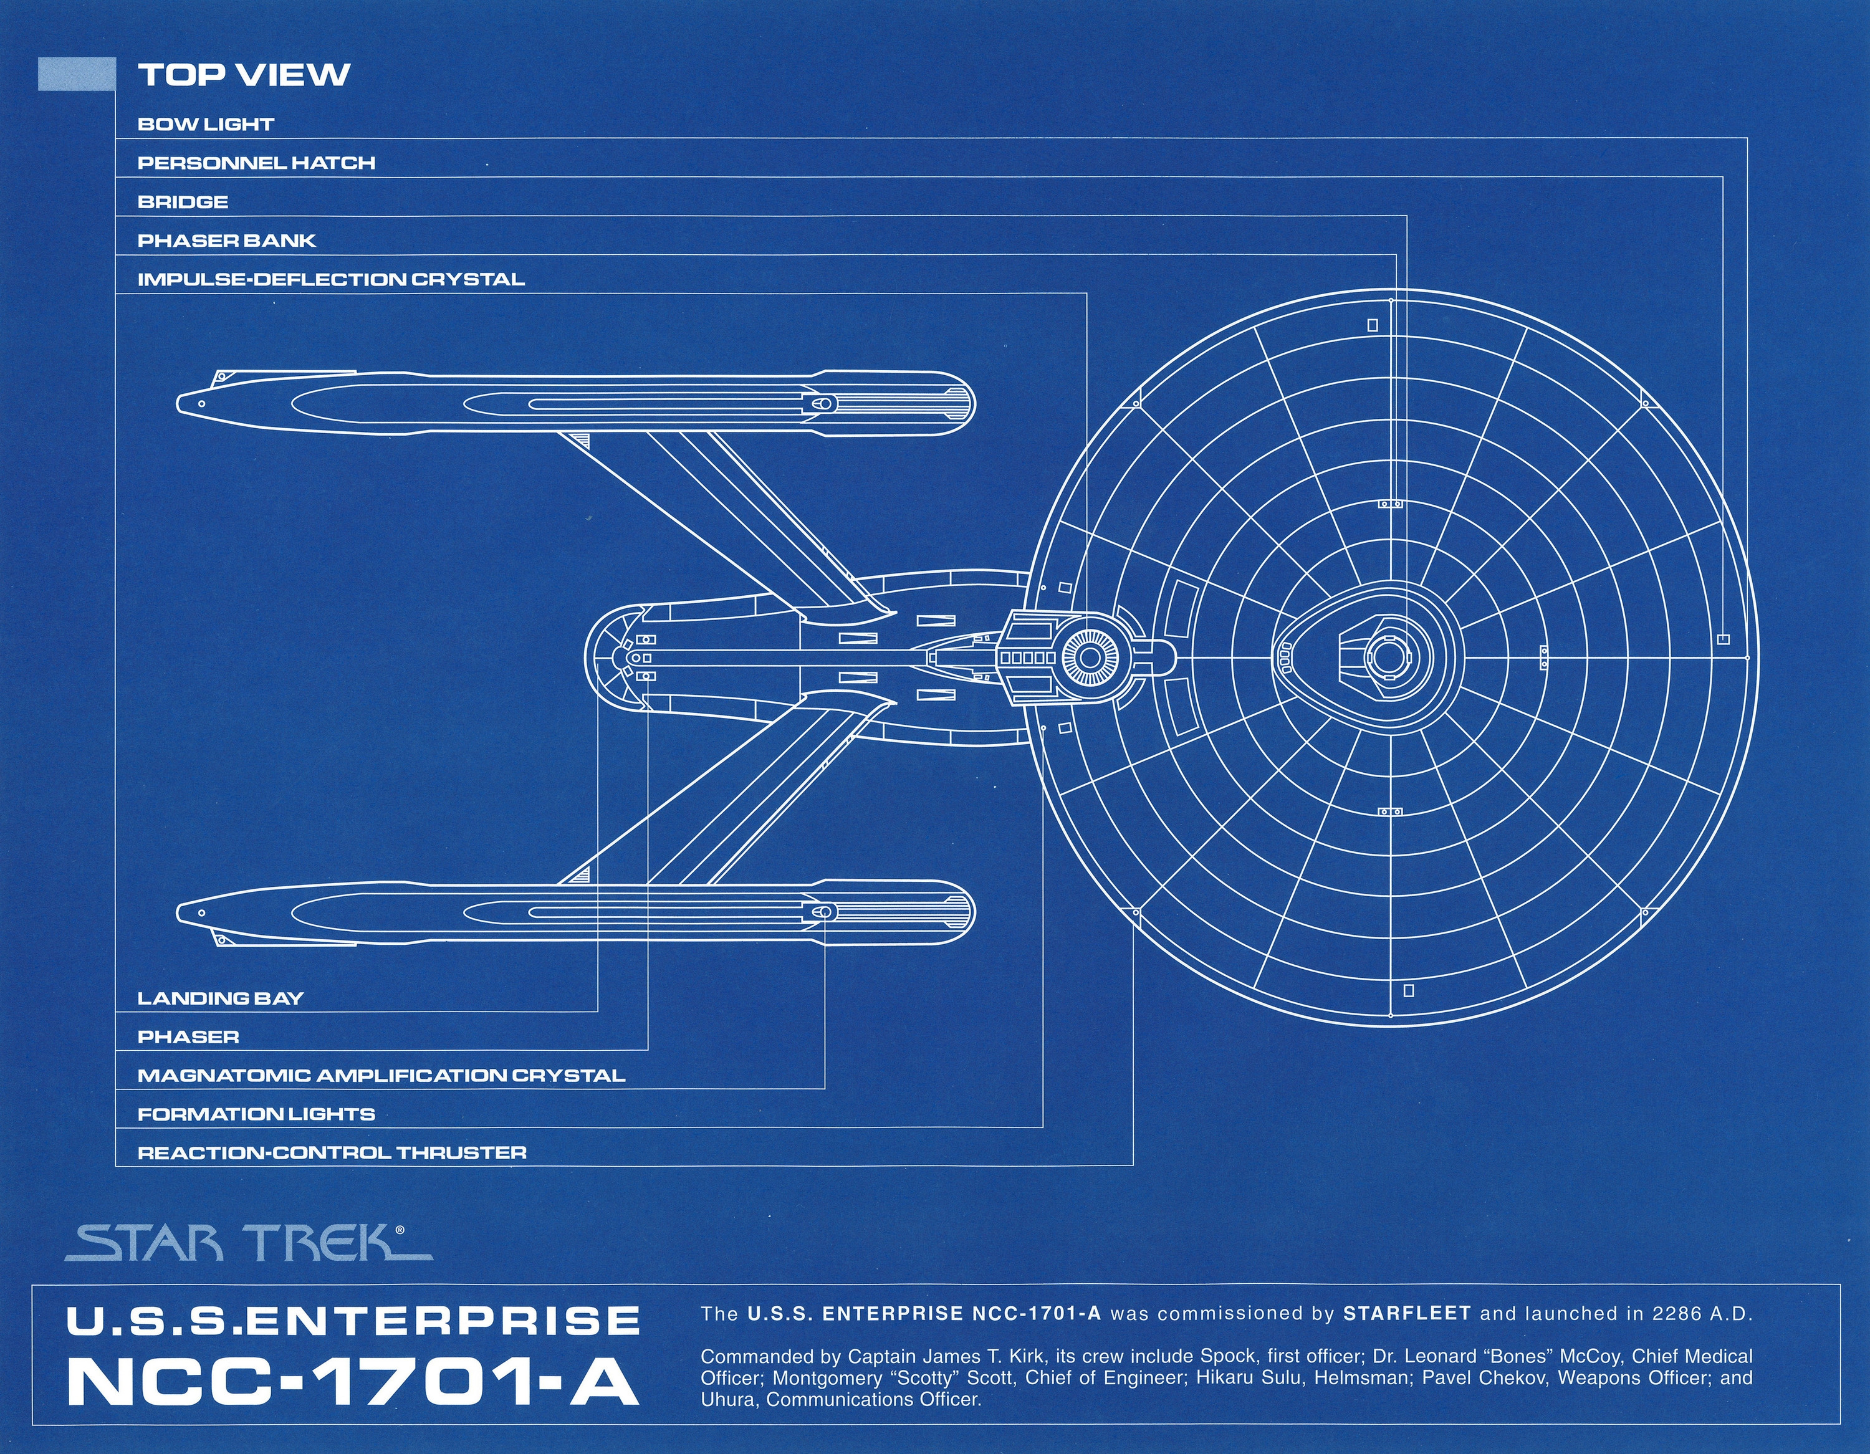

Slide 19
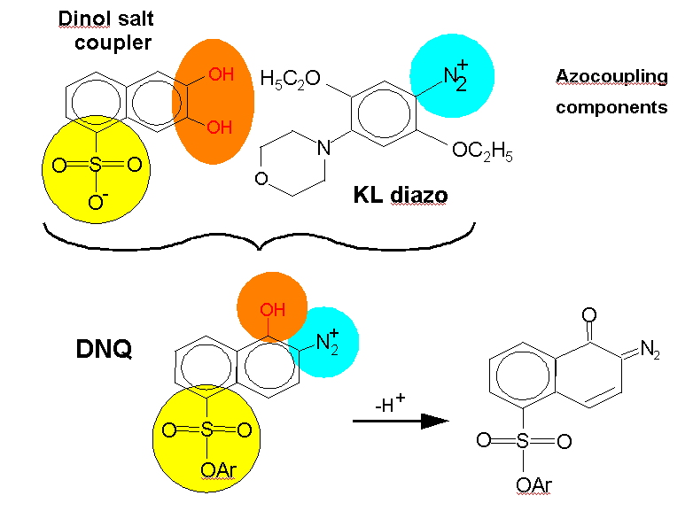

Slide 20
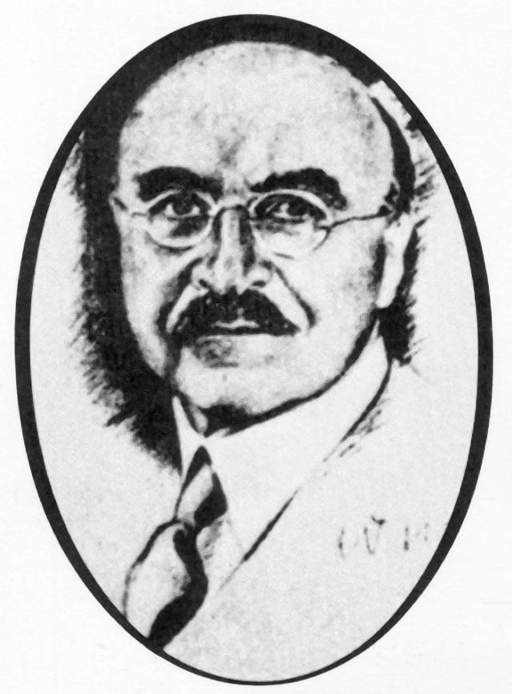
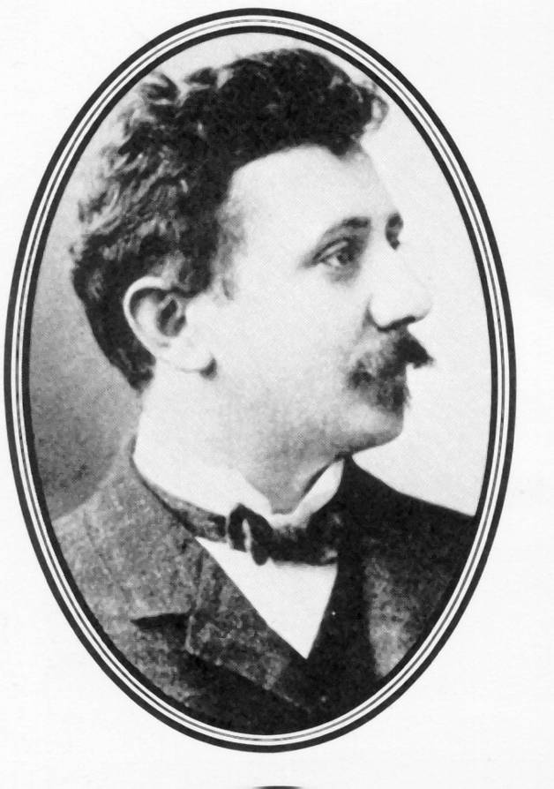
The History of Novolac
C.H. Meyer and L.H. Baekeland Discovered Novolac ca. 1900
Baekeland
Meyer

Slide 21

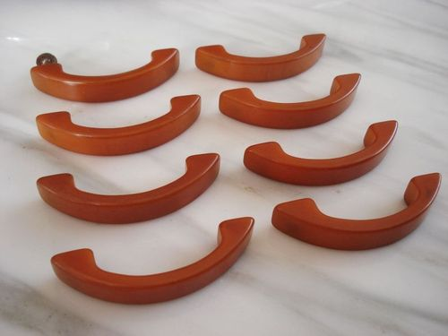
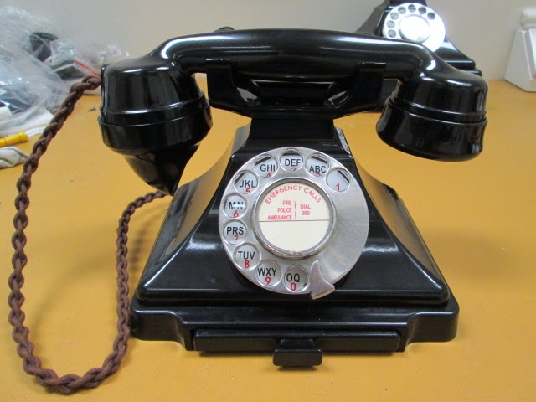
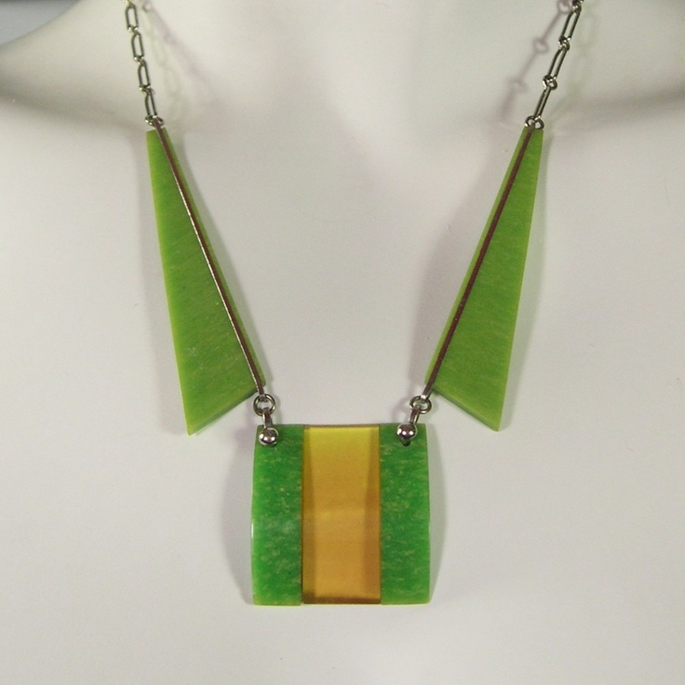
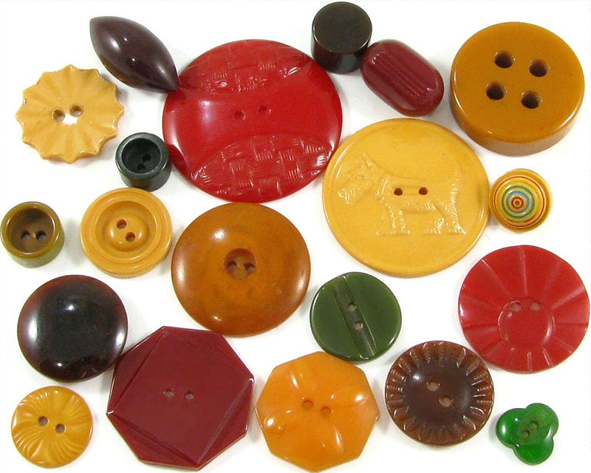

Slide 22
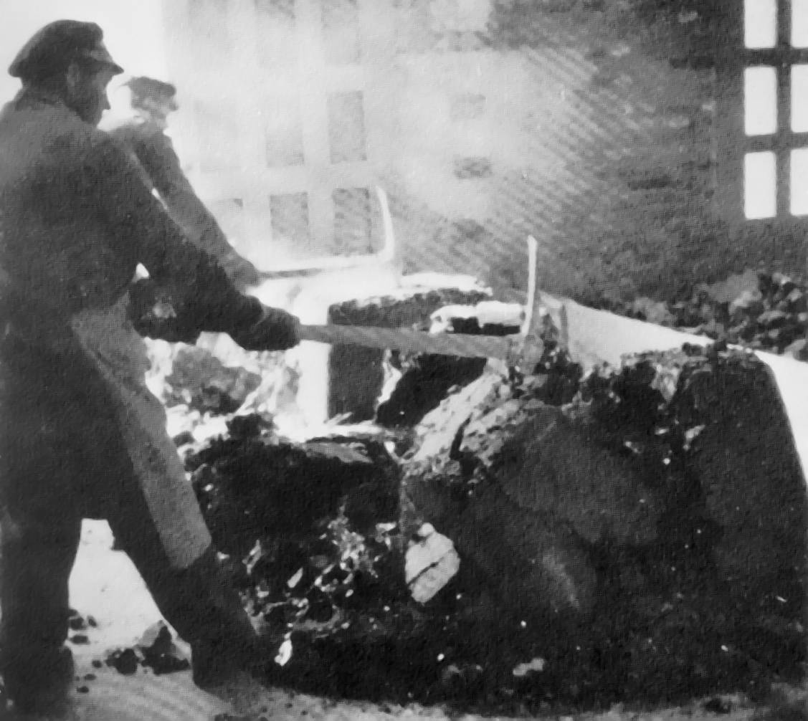
Novolac Resin Production!!
Workers at Albert Co. in Wiesbaden, Germany
“zerkleinert das Harz von Hand” (ca. 1910)

Slide 23
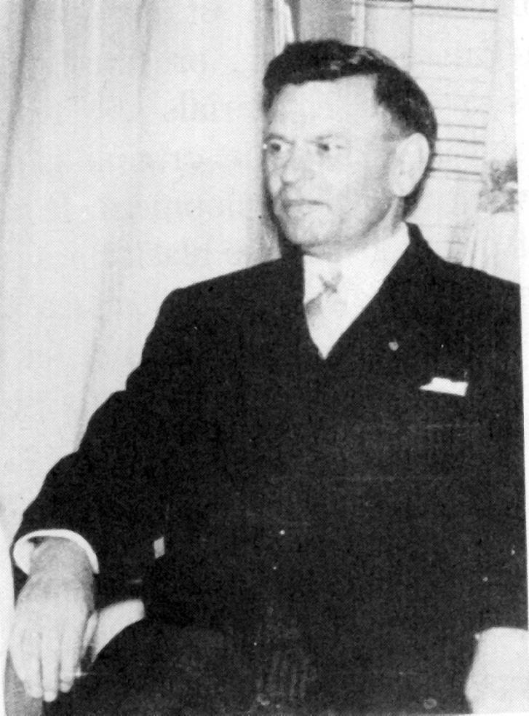
Oskar Süẞ
Der Diazo König

Slide 24




Slide 25
Novolac/DNQ Photoresists
I
I
I
I
I
I
I
I
I
I
I
I
Coat
UV
Substrate
UV
Inhibited Novolac (I)
Photoproduct (P)
I
I
P
P
P
I
I
P
I
I
P
P
P
I
I
Expose
Novolac
Substrate
LogR
I
I
I
I
365-nm exposure
I
I
I
I
Develop
Add DNQ
Substrate
I
Notes:
The first example -- Diazonaphthoquinone/Novolac chemistry.
These photoresists operate by taking the base soluble polymer, novolac and adding a small amount of a photoactive dissolution inhibitor, diazonaphthoquinone.
Adding the DNQ causes the dissolution rate of the resist to decrease by several orders of magnitude.
The DNQ acts as the photochemically solubility switch, such that upon exposure to 365 nm light, it’s converted to a carboxylic acid.
And this exposed resist has a higher dissolution rate than the novolac alone.
The result of this change in dissolution rate is a resist image with a nearly vertical sidewall profile.
Looking at this, you’d think that the perfect resist already exists .. And it does ... Unless you want to decrease the size of the image.

Slide 26
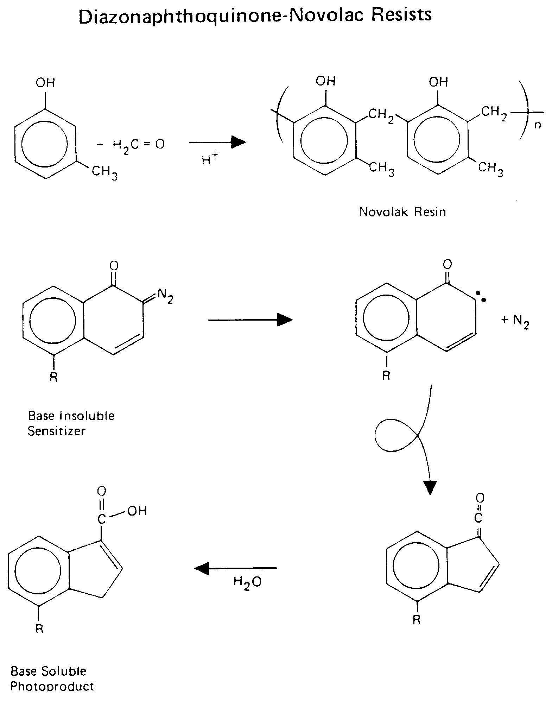
DNQ – Novolac Resists

Slide 27
Wolff Rearrangement and Reaction of the ketene with water

Slide 28
